Slide 1
Lecture 12 – Generative Adversarial Networks
Prof. André Gustavo Hochuli
gustavo.hochuli@pucpr.br
aghochuli@ppgia.pucpr.br
Notes:
Prof. André Hochuli

Slide 2
Topics
Review of Lecture 11 – Image Segmentation
Generative Adversarial Networks
DCGAN
PIX2PIX
CycleGAN
Practice
Computer Vision - Prof. André Hochuli
Lecture 12
Notes:
Prof. André Hochuli

Slide 3
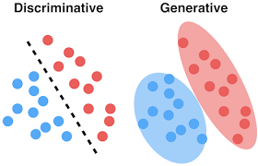
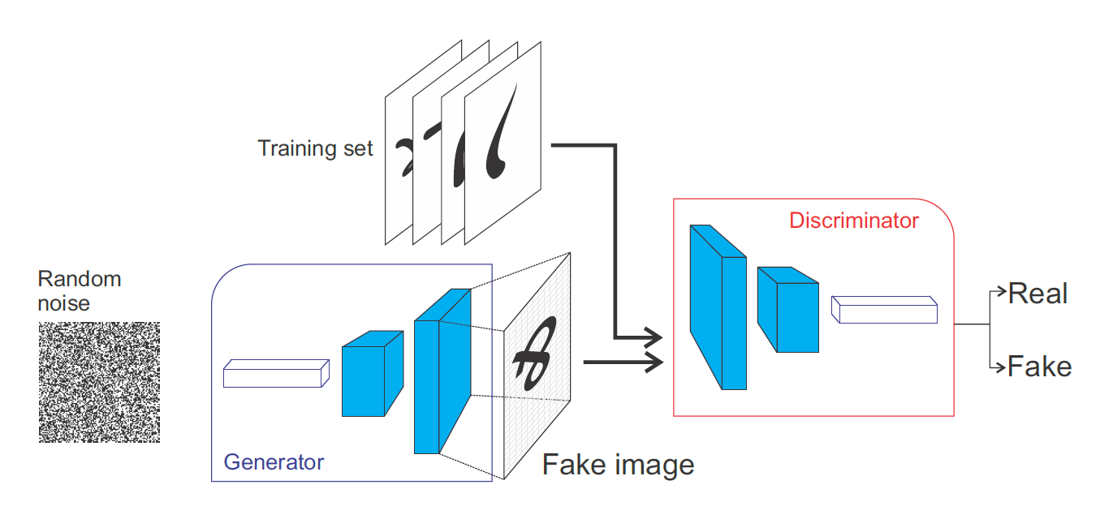
Generative Adversarial Networks (GAN’s)
Generator: Noise → Data
Discriminator: Classification
Computer Vision - Prof. André Hochuli
Lecture 12
Notes:
Prof. André Hochuli

Slide 4
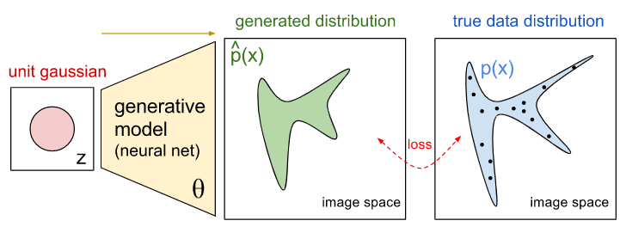
Generative Model
Learns data distribution
Computer Vision - Prof. André Hochuli
Lecture 12
Notes:
Prof. André Hochuli

Slide 5
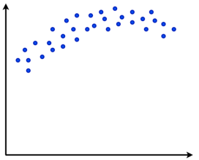
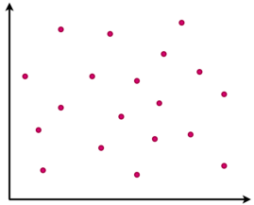
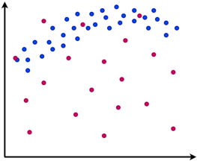
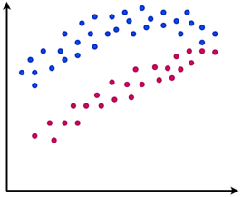
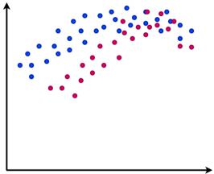
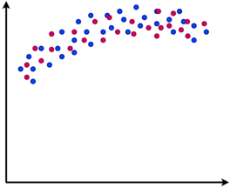
Generative Model
Real
Fake
Training
Computer Vision - Prof. André Hochuli
Lecture 12
Notes:
Prof. André Hochuli

Slide 6
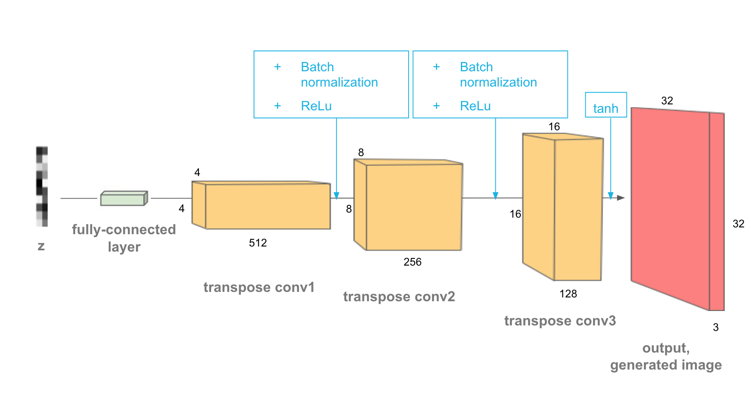
Deep Convolutional Generative Model
De-Convolutional Layers
Noise to Fake Image
Computer Vision - Prof. André Hochuli
Lecture 12
Notes:
Prof. André Hochuli

Slide 7
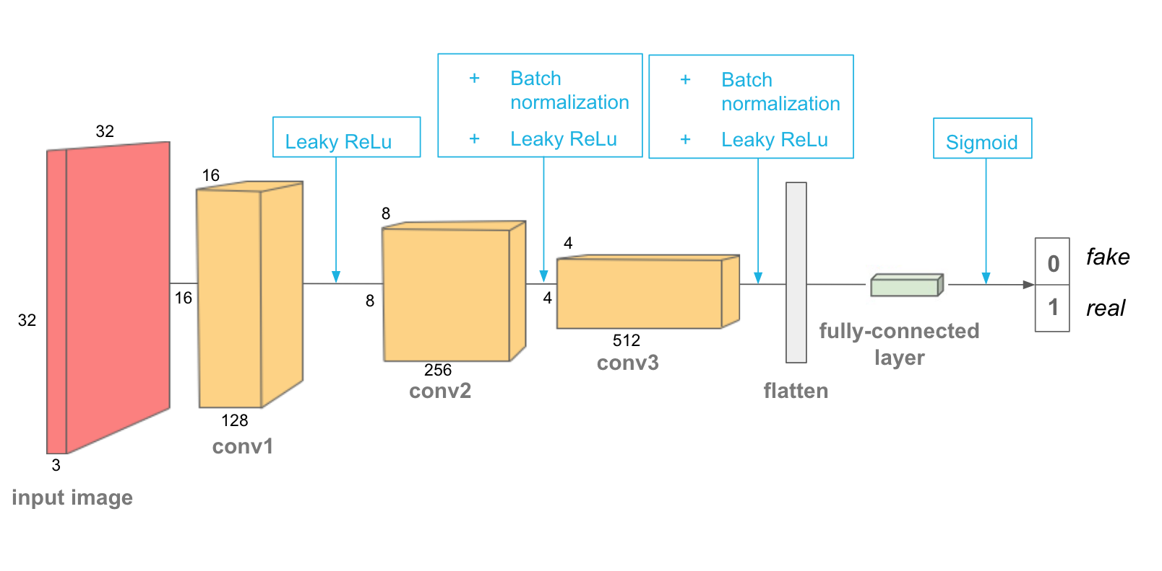
Discriminator Model
Classification: Fake or Real
CNN
Computer Vision - Prof. André Hochuli
Lecture 12
Notes:
Prof. André Hochuli

Slide 8
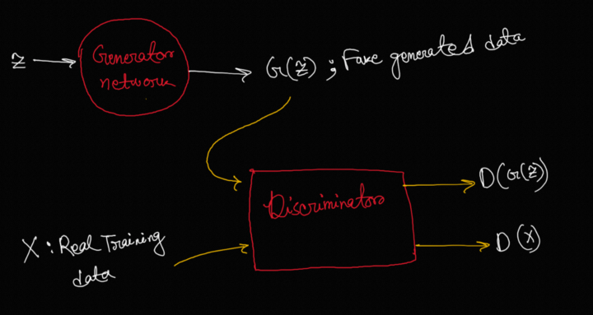
Adversarial Training
Min-Max
Computer Vision - Prof. André Hochuli
Lecture 12
Notes:
Prof. André Hochuli

Slide 9
Let’s Code
https://www.tensorflow.org/tutorials/generative/dcgan
Computer Vision - Prof. André Hochuli
Lecture 12
Notes:
Prof. André Hochuli

Slide 10
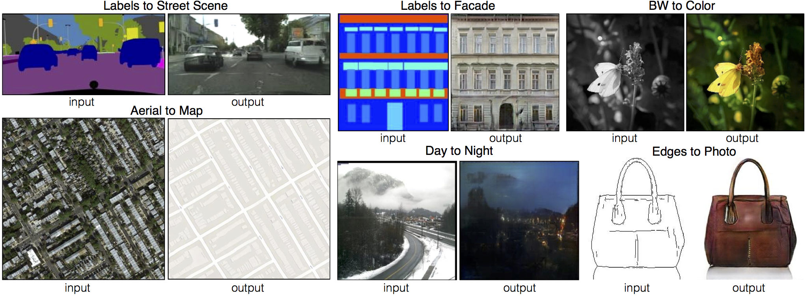
Pix2Pix
Image-Translation
Computer Vision - Prof. André Hochuli
Lecture 12
Notes:
Prof. André Hochuli

Slide 11
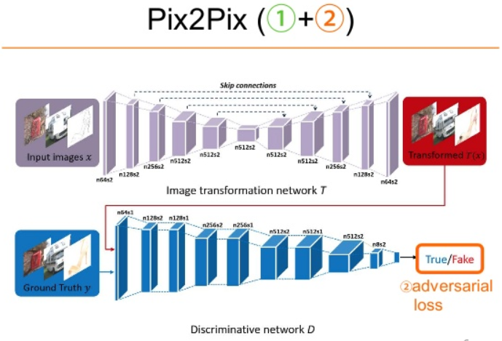
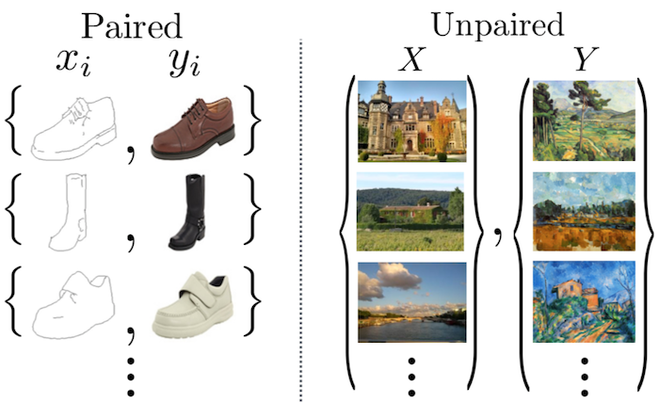
Pix2Pix
Generative Model: Encoder-Decoder Architecture (i.e U-Net)
Paired Annotated Dataset
Computer Vision - Prof. André Hochuli
Lecture 12
Notes:
Prof. André Hochuli

Slide 12
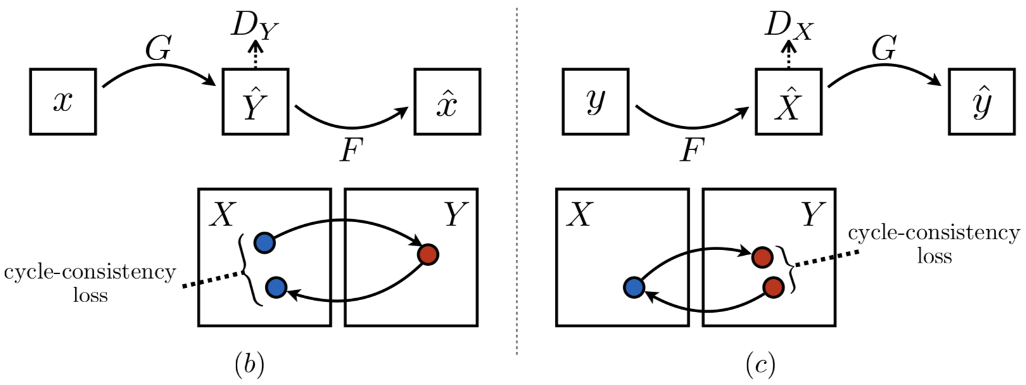
Cycle-GAN
4 Networks
2 Generators
2 Discriminators
Unpaired Annotated Dataset
Computer Vision - Prof. André Hochuli
Lecture 12
Notes:
Prof. André Hochuli

